Slide 1
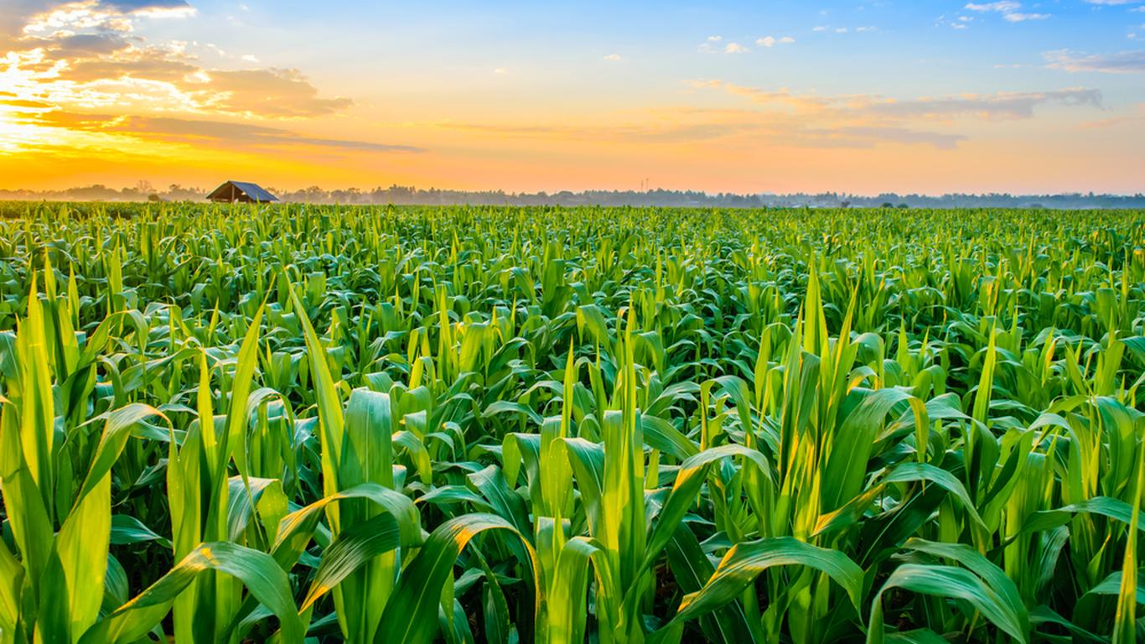
An IoT Based Smart Infrastructure Management on Cloud

Slide 2

Dr. Jerry Gao
PROFESSOR:

Slide 3

Hemaprasanthi Mutyala Maahi Chatterjee Wenyan He Lakshmi Kameswari Maduri
STUDENTS:

Slide 4
What makes a smart agriculture smart?

Slide 5
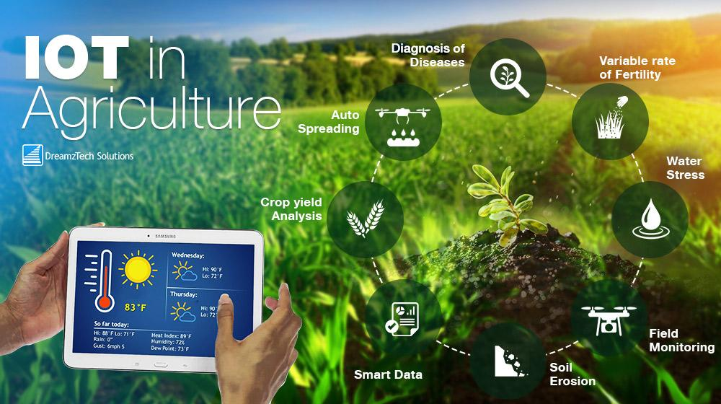

Slide 6
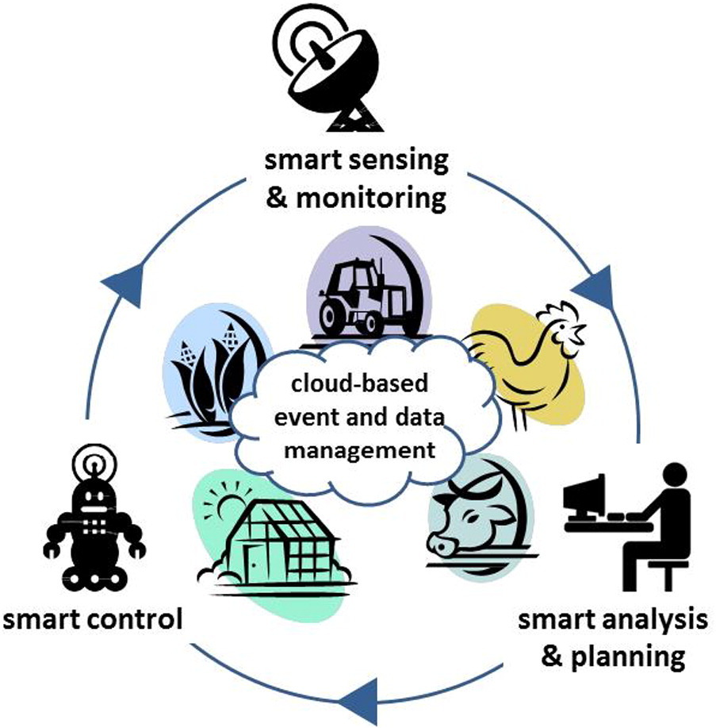
SMART RANCH
Smart Ranch is a hot topic that has started trending at the top of the IOT world in the past few years.
The IOT-based smart agriculture infrastructure management system encapsulates this logical premise and provides a semi-autonomous ranch system towards building a smart agriculture.

Slide 7
Objectives
Sensor installation, registration and tracking
Data collection from sensors and data management
Data analysis and report generation
Protected data access

Slide 8
System Users/Actors
Clients - The persons who access the system to collect sensor data and view different reports.
Infrastructure manager – The persons who setup, configure, and manage smart clusters, nodes, and sensors, as well as their connections.
IOT Support – The persons who access the system to find out the status of smart nodes, clusters, and sensors.

Slide 9
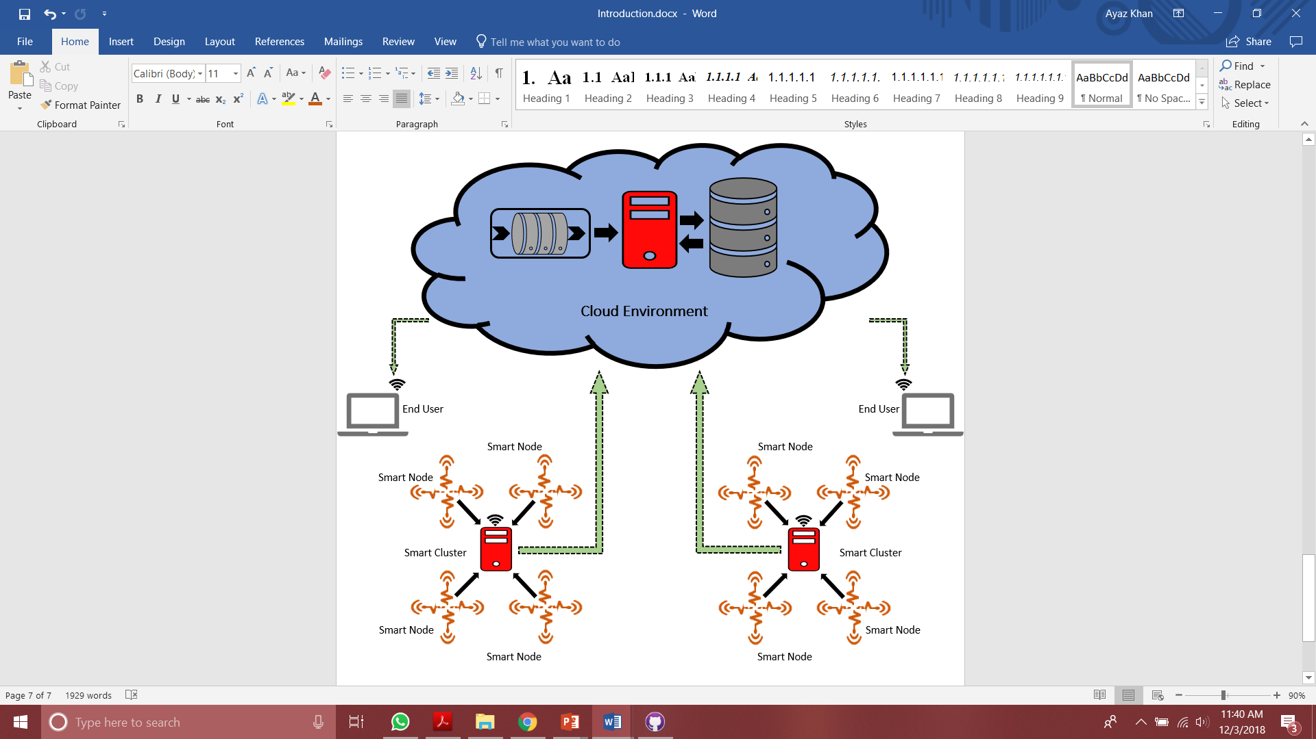
System Overview

Slide 10



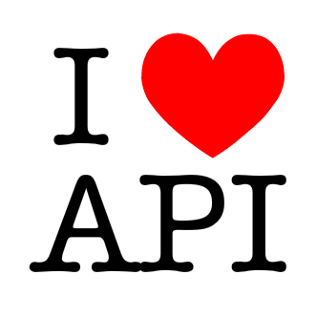

Architecture Style
Micro Services
Client side MVC
Reactive Applications
API-First
Cloud Deployment

Slide 11
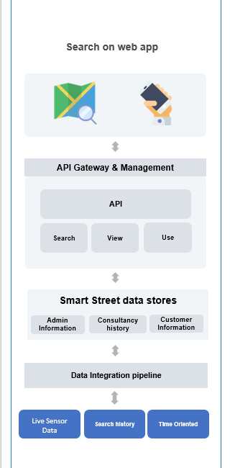
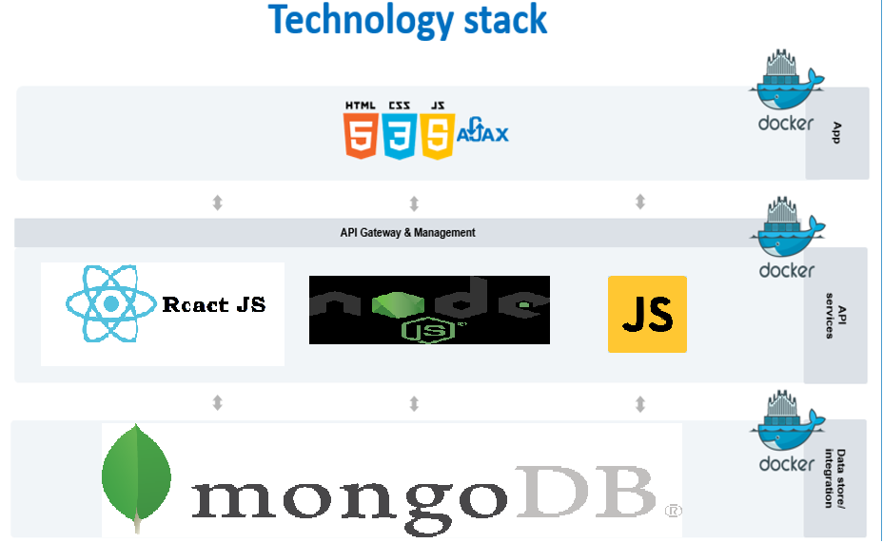
EC2

Slide 12
An IOT infrastructure manager for smart ranchs
A simulated sensor station
System function components
An IOT smart ranch data manager
System Dashboard

Slide 13
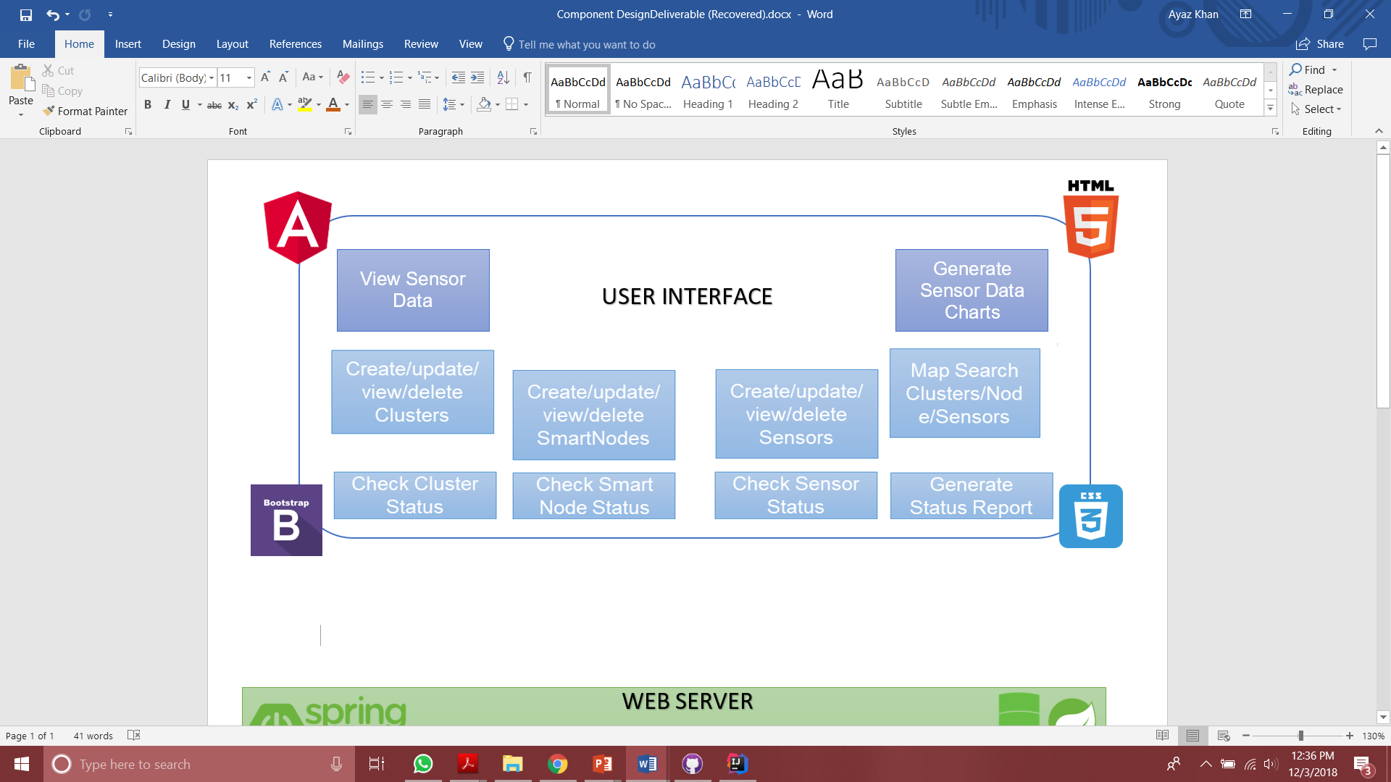
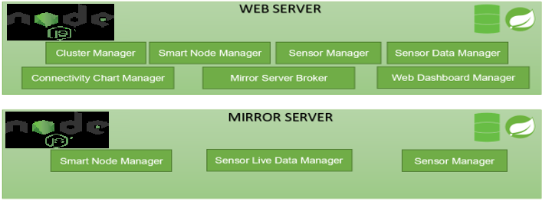
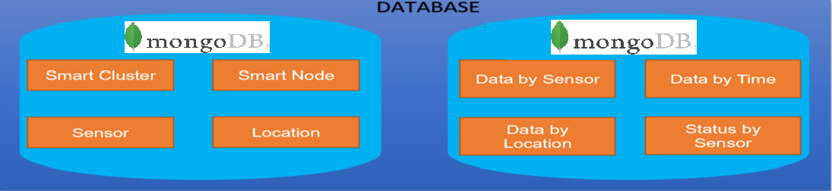
CLOUD
SOLUTION ARCHITECTURE

Slide 14
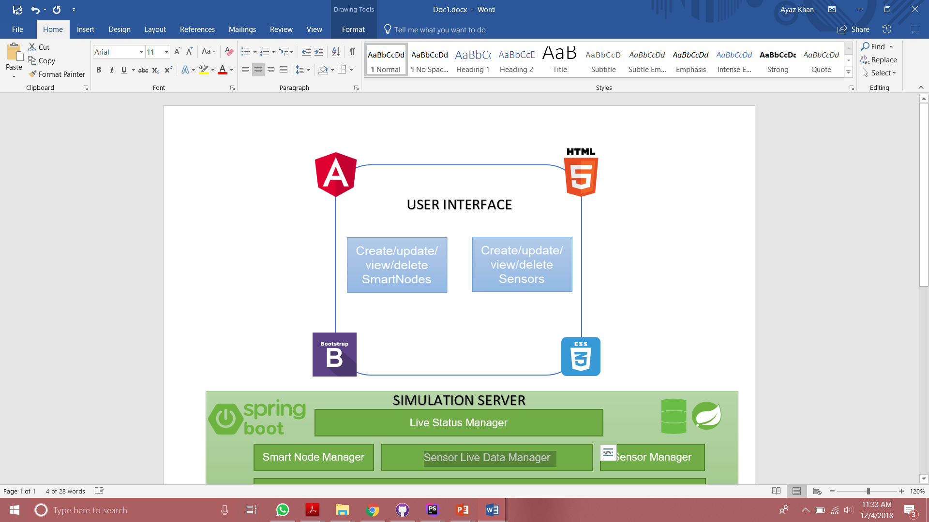
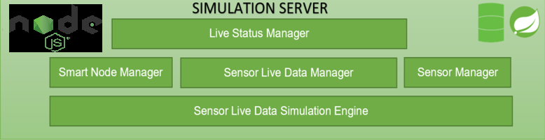
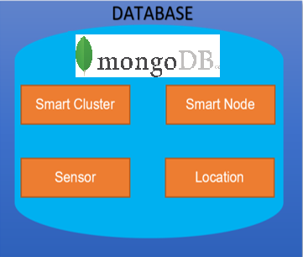
SIMULATED
SENSOR
SOLUTION ARCHITECTURE

Slide 15
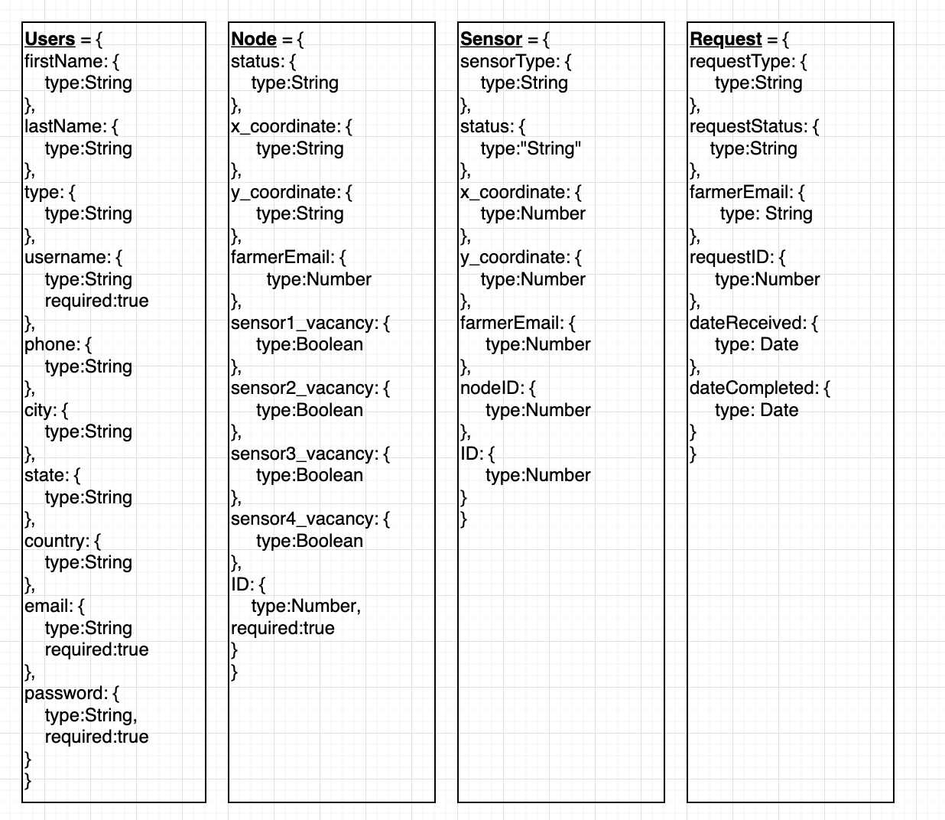
Database Design: MongoDB
List Of Collections

Slide 16












DEPLOYMENT ARCHITECTURE
Virtual network
High Availability set
Web Server API
Simulated Station Physical Layer
Web layer
Elastic Load Balancer
High Availability set
Users
Mirror Server API
Simulated Cluster
Mirror layer
High Availability set
Mirror Server API
Simulated Cluster
AWS
Code Build
Mirror layer
Devices
AWS EC2 Connect
High Availability set
Mirror Server API
Simulated Cluster
EC2
Cassandra Database layer
My SQL Database layer

Slide 17
Load Balancer
Least connection algorithm applied in implementation
Monitors TCP/IP traffic for incoming workload
Keeps track of latest number of connections in DB for each server
Assigns the workload to the server that has the least connections
LB log supports tracing dynamic workload

Slide 18
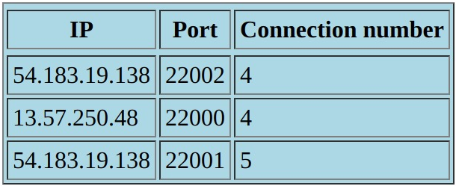
Load Balancer -- Example
Server specified by IP:port
Same IP, different ports implies same EC2 instance but different accounts (due to cost concerns)

Slide 19
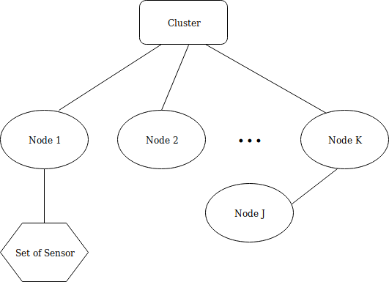
Simulated Smart Station Structure
Smart mesh network
Node J connects to Node K, instead of Cluster. Could connect to another node if necessary.

Slide 20
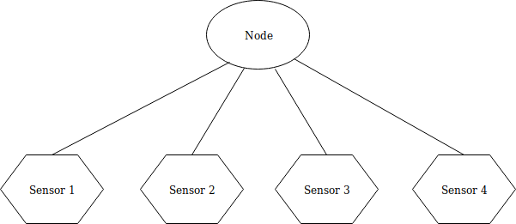
Simulated Smart Station Structure
Up to 4 sensors under each node
Sensor type: temperature, air humidity, soil moisture, soil pH value
Simulation of physical sensors

Slide 21
Infrastructure Manager Responsibilities
This component allows framers to build their desirable sensor networks with diverse sensors in well-defined process below:
Select one sensor network for an agriculture sensor network
Select and configure different sensors for a smart node and its location in a ranch or (a greenhouse) using a floor plan.
Select and configure smart sensor nodes (or cluster nodes)
Deploy and connection validation
In addition, this component supports the following management functions for sensor network.
(a) Cluster node management: It allows clients to add/update/delete/view cluster nodes for an agriculture IOT sensor network, and track cluster node status.
(b) Smart node management: It allows clients to add/update/delete/view smart nodes controlled by a cluster, and track node status.

Slide 22
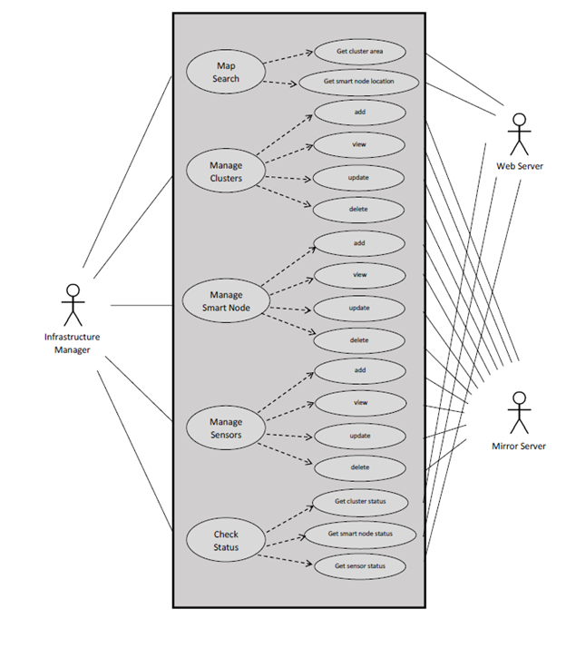
Infrastructure Manager Use Case

Slide 23
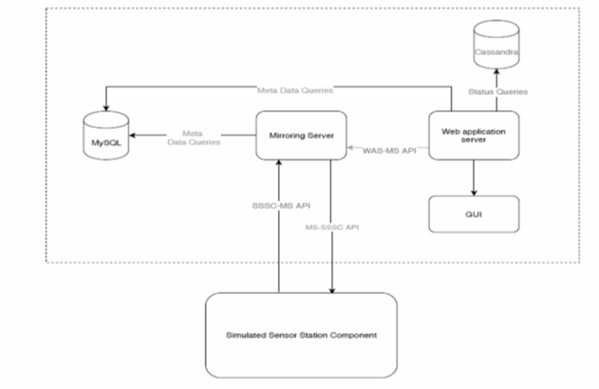
Infrastructure Manager API Design

Slide 24
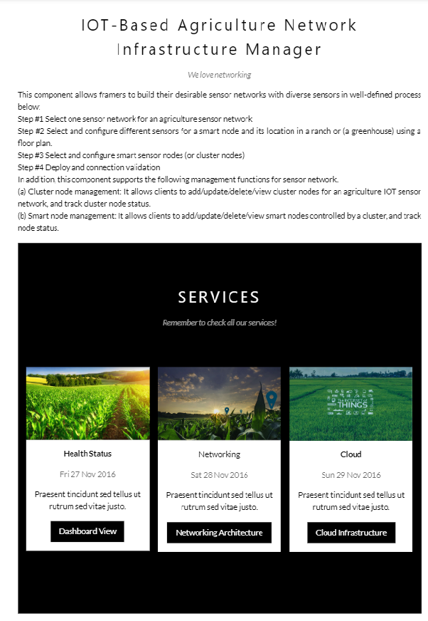
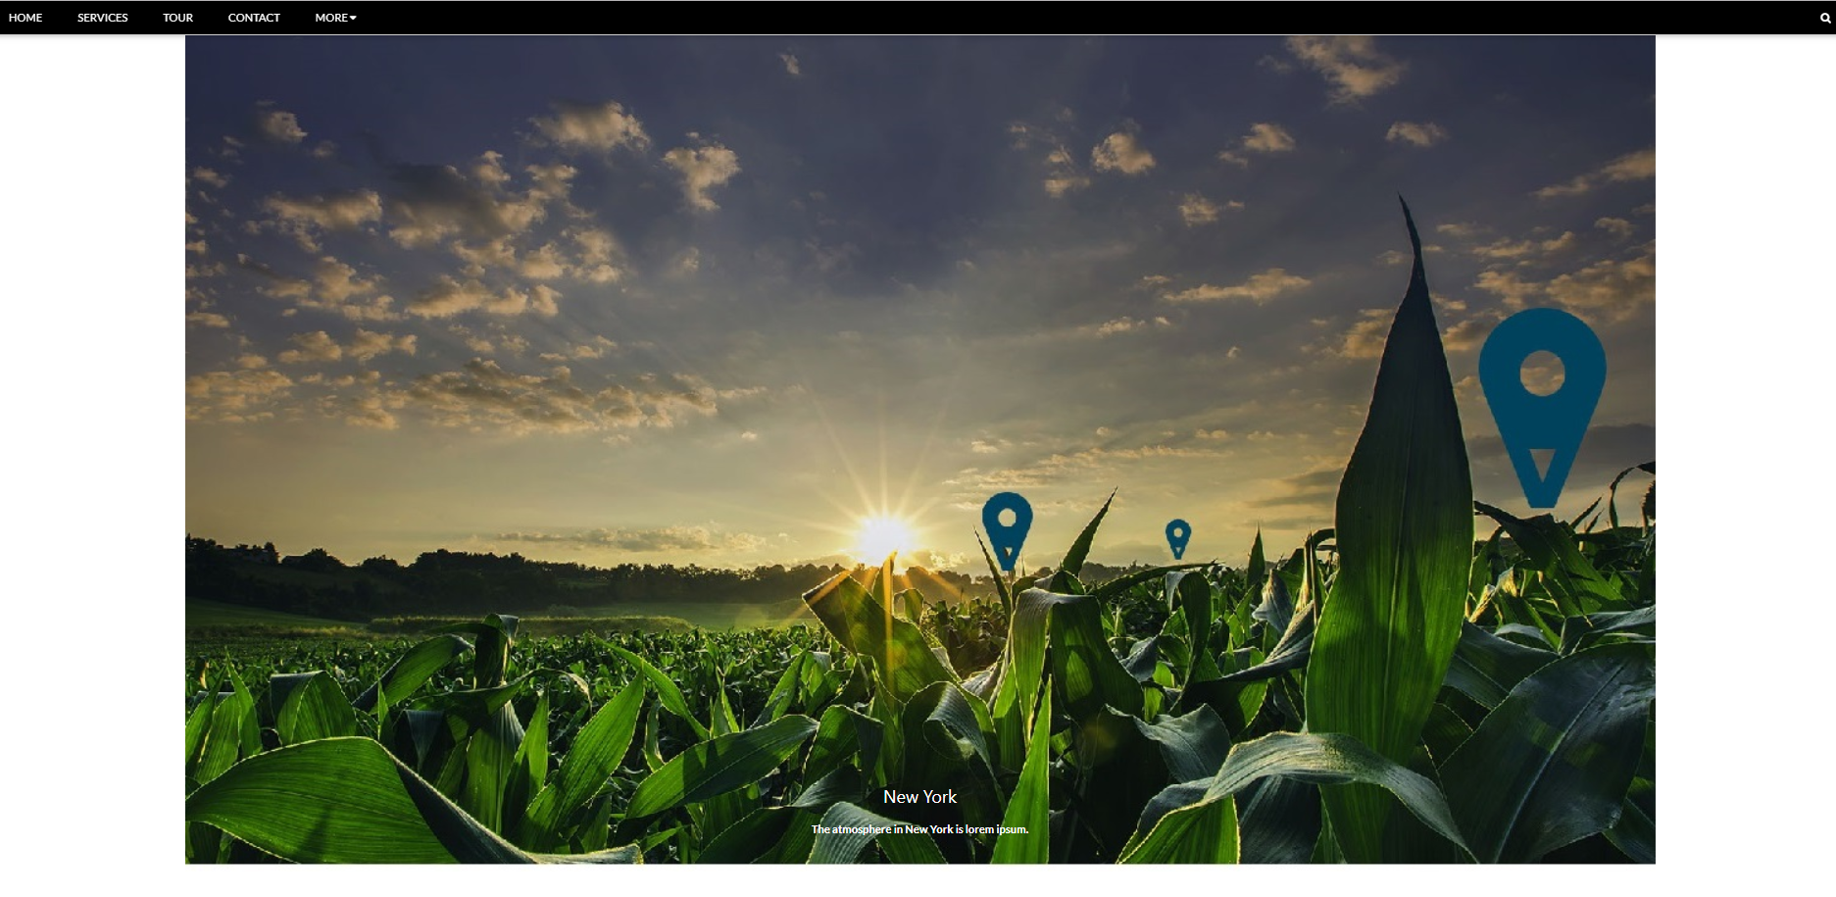
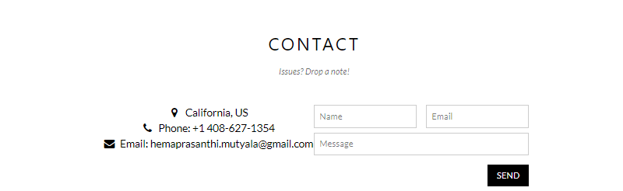
Home Page UI

Slide 25
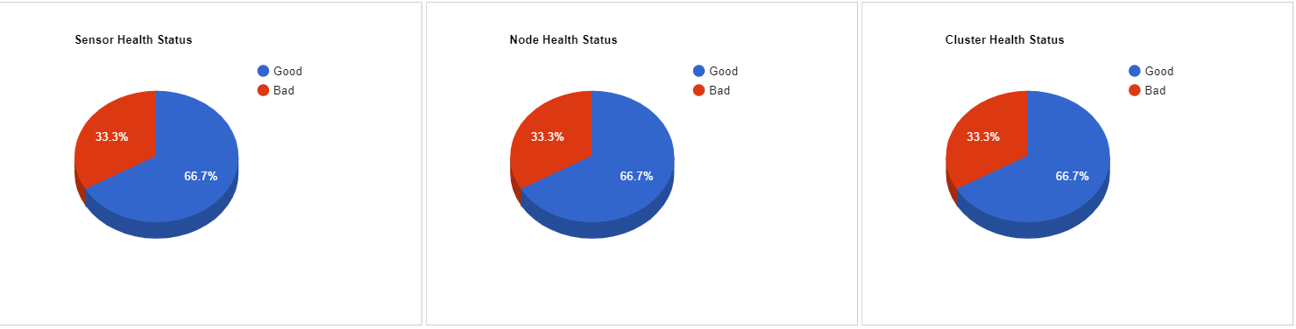
Health Status UI

Slide 26
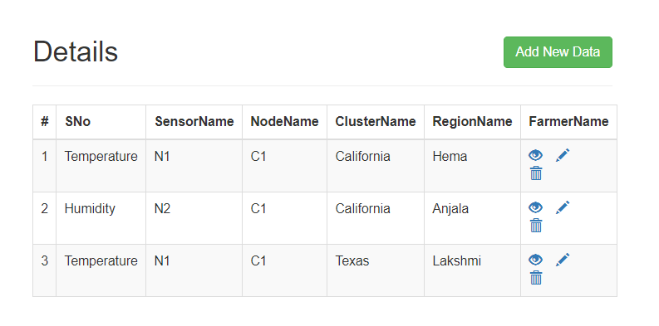
Networking

Slide 27
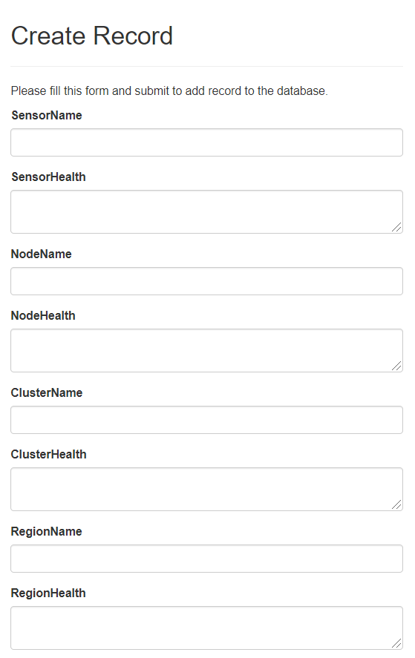
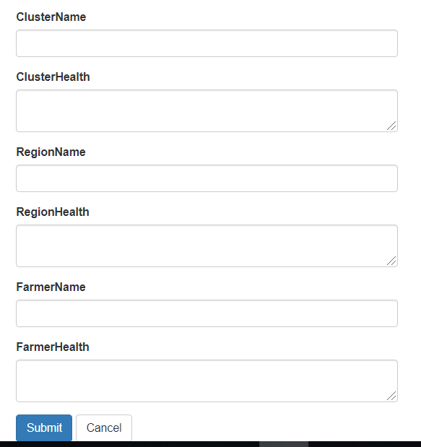
Add a node/sensor/cluster

Slide 28
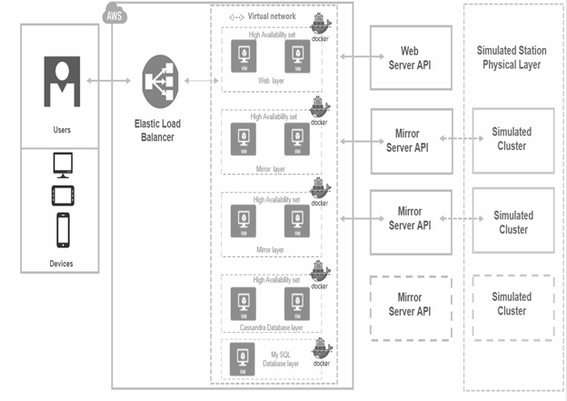
Cloud View

Slide 29
IOT Support
View the list of farmers farmers whom he is responsible
Add/delete a node to the farm
View all nodes and sensors in the farm
View the status of nodes and sensors in the farm

Slide 30
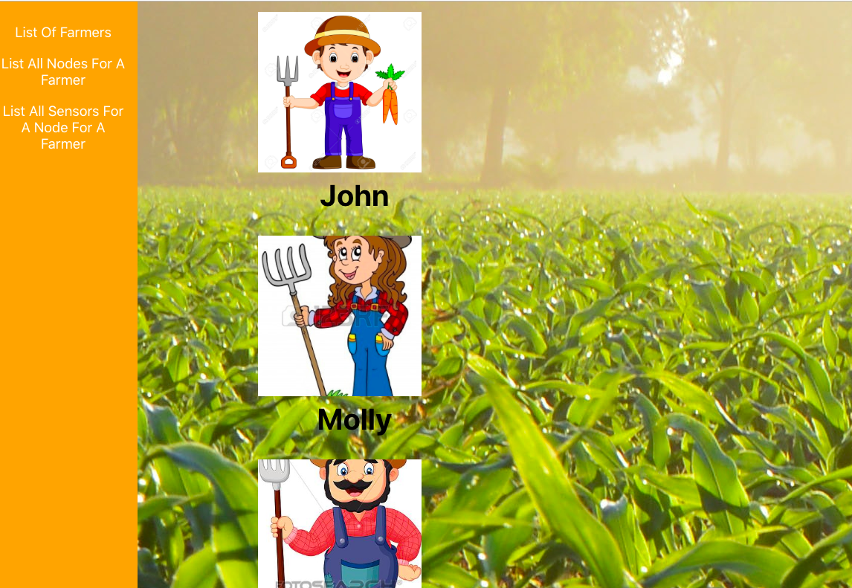
View List Of Farmers

Slide 31
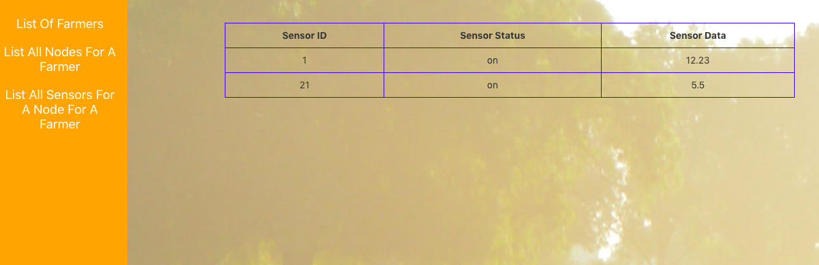
View all sensors in the farm

Slide 32
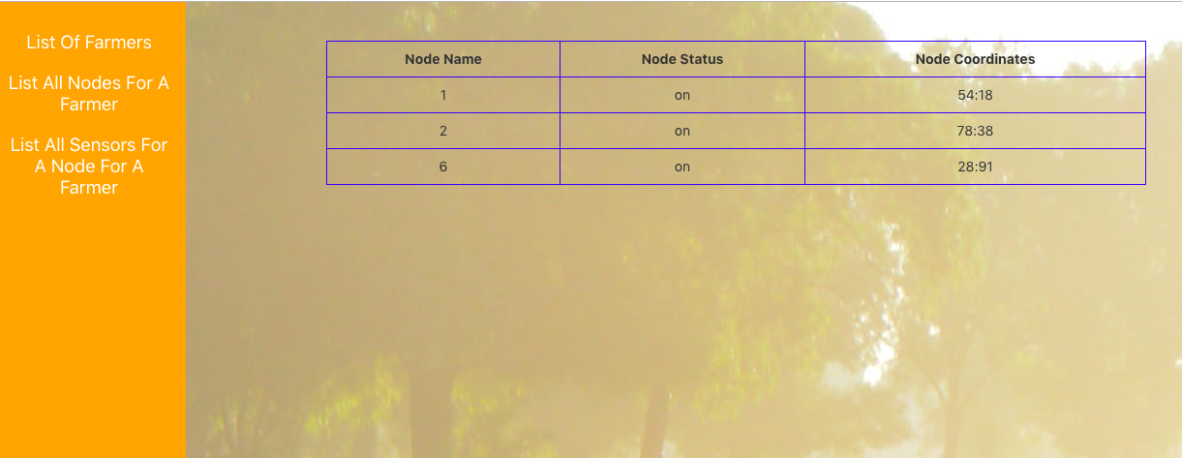
View all nodes in the farm

Slide 33
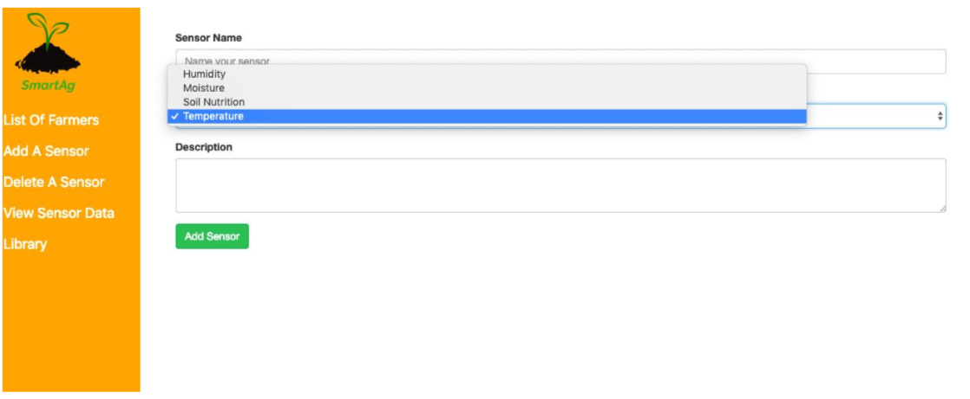
Add a new sensor upon Farmer’s request

Slide 34
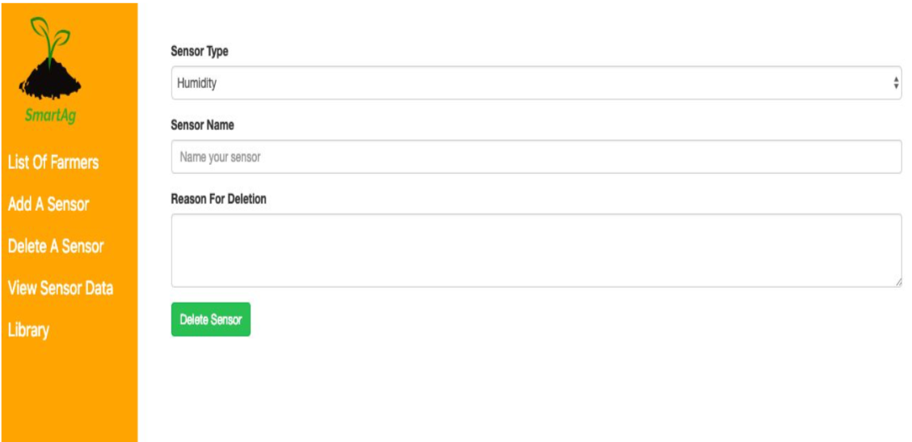
Delete a sensor upon Farmer’s request

Slide 35
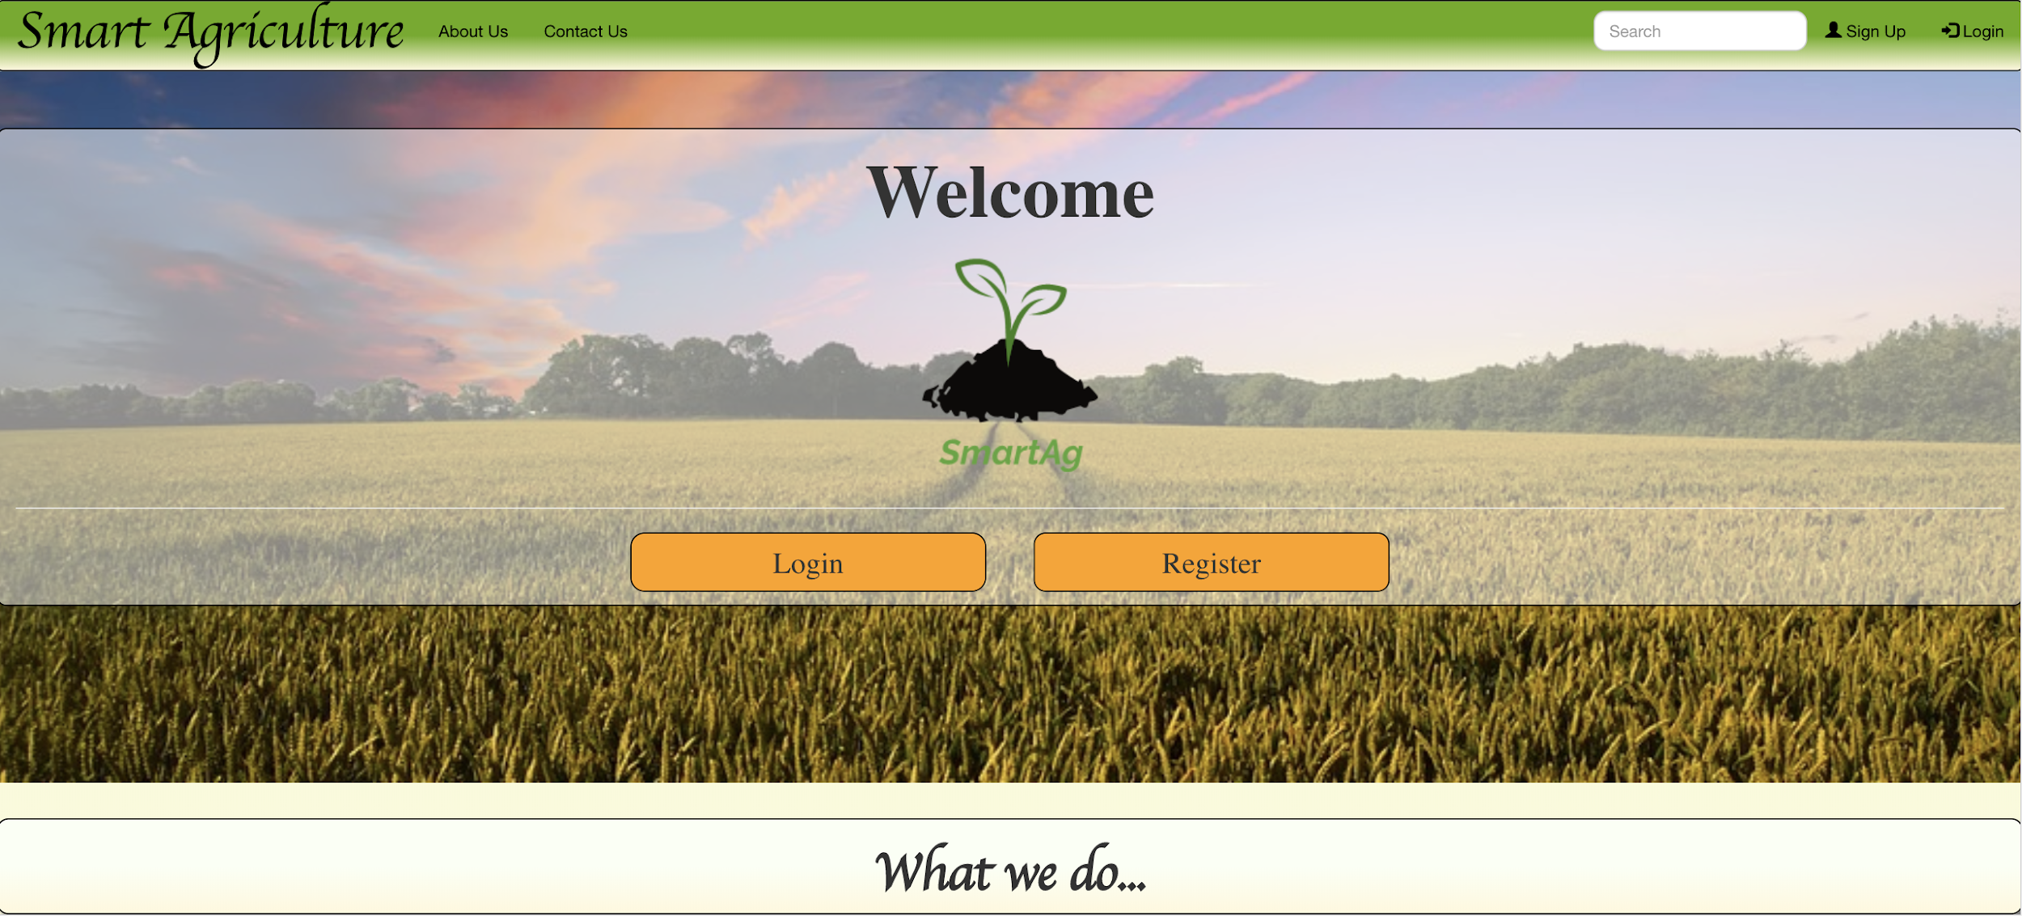
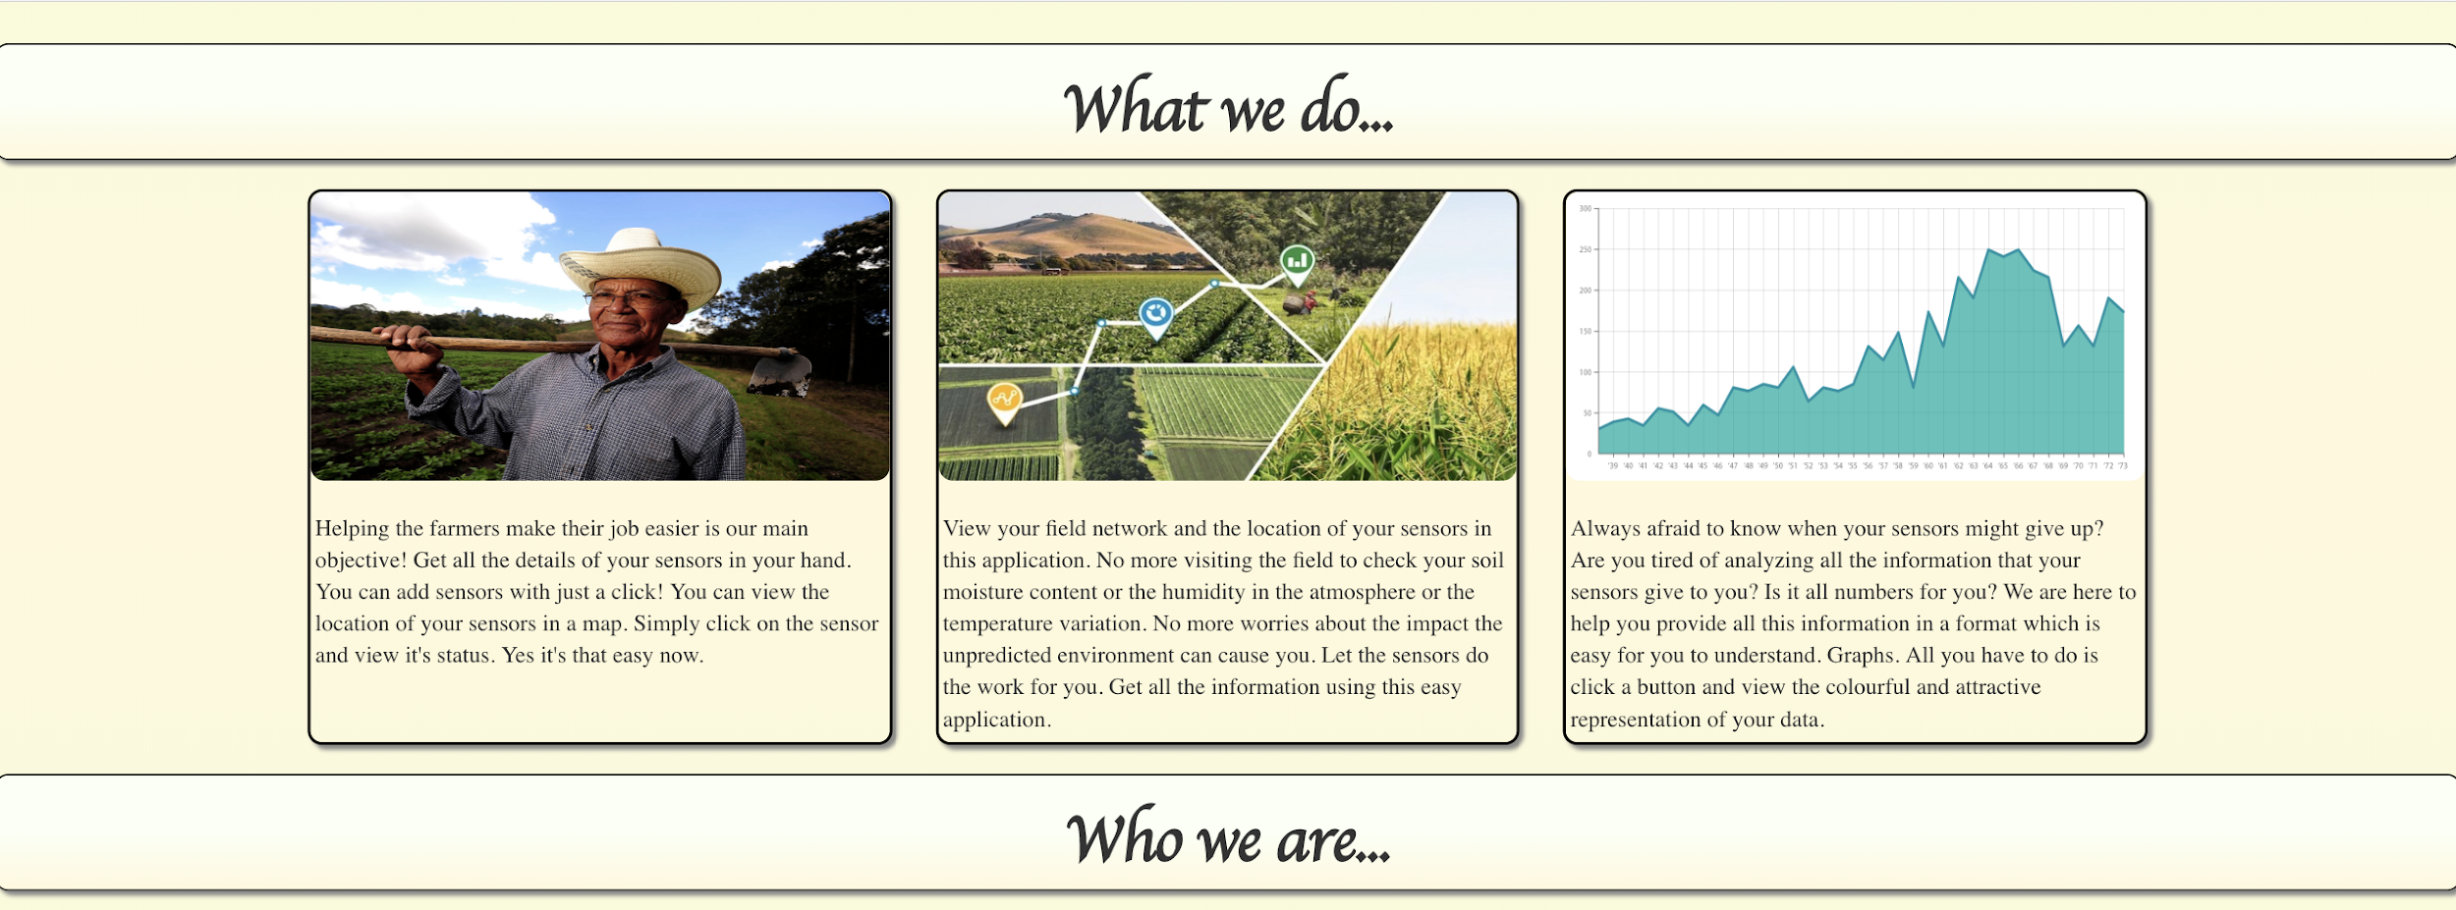
System Dashboard-Home Page

Slide 36

System Dashboard-Home Page

Slide 37
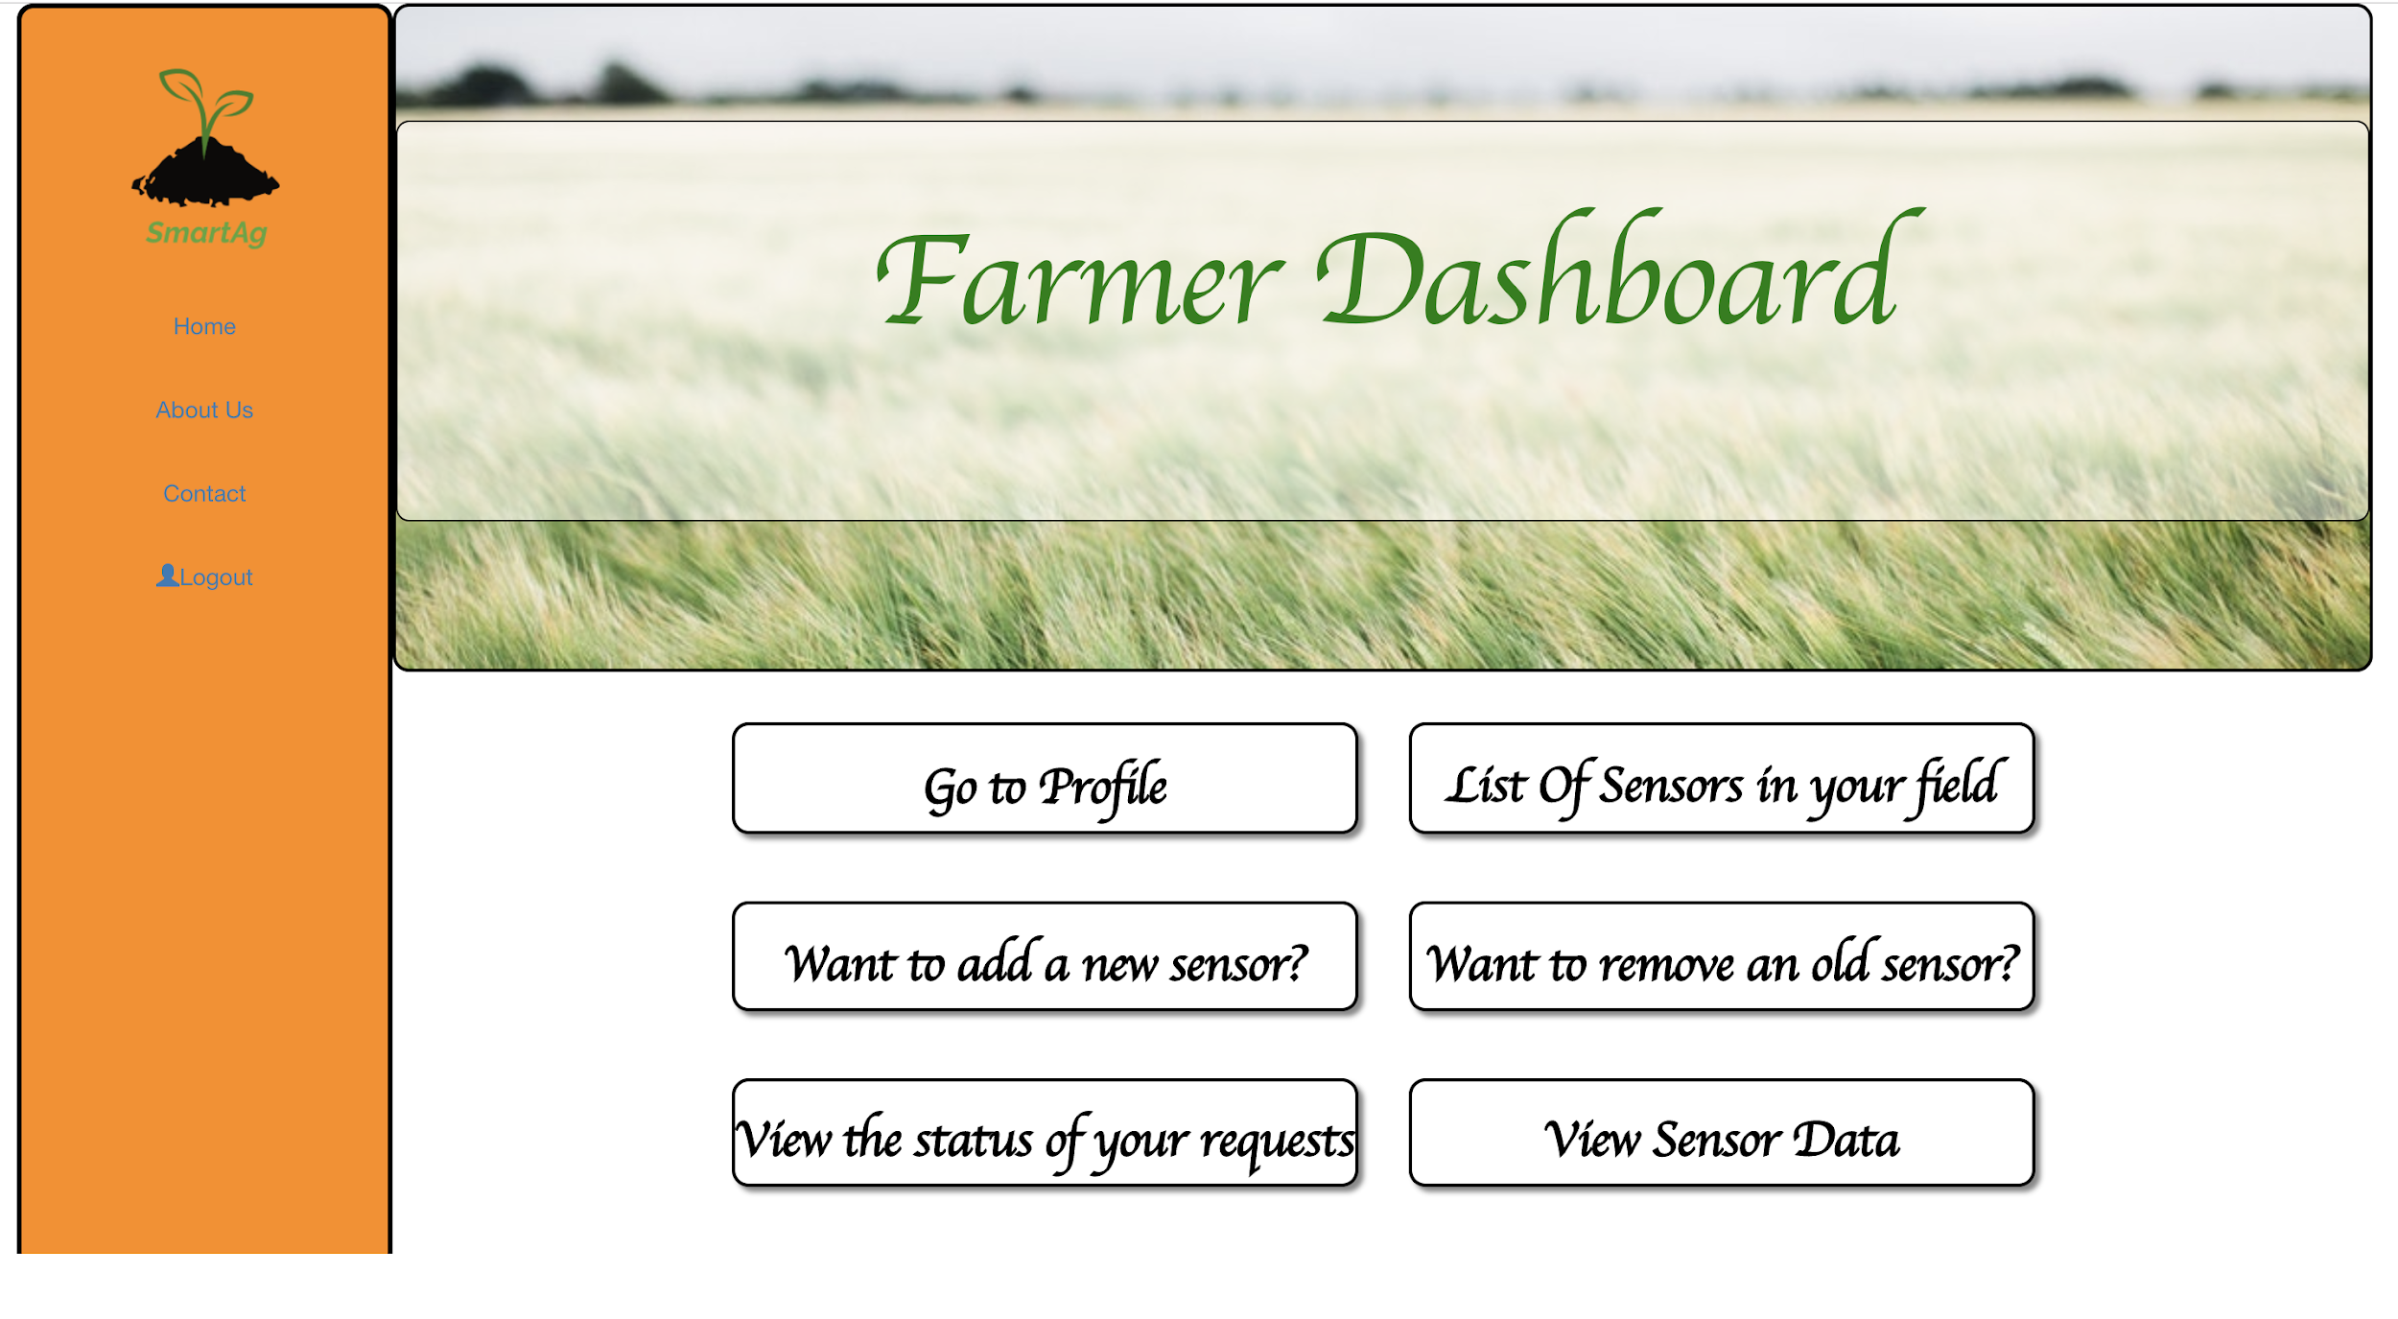
System Dashboard-Farmer
Farmer Dashboard
List of Options given to the Farmer:
List of Sensors in the field
Request to add a sensor
Request to remove a sensor
View the status of the requests(Add/Remove Sensor)
Sensor Data for individual Sensors

Slide 38
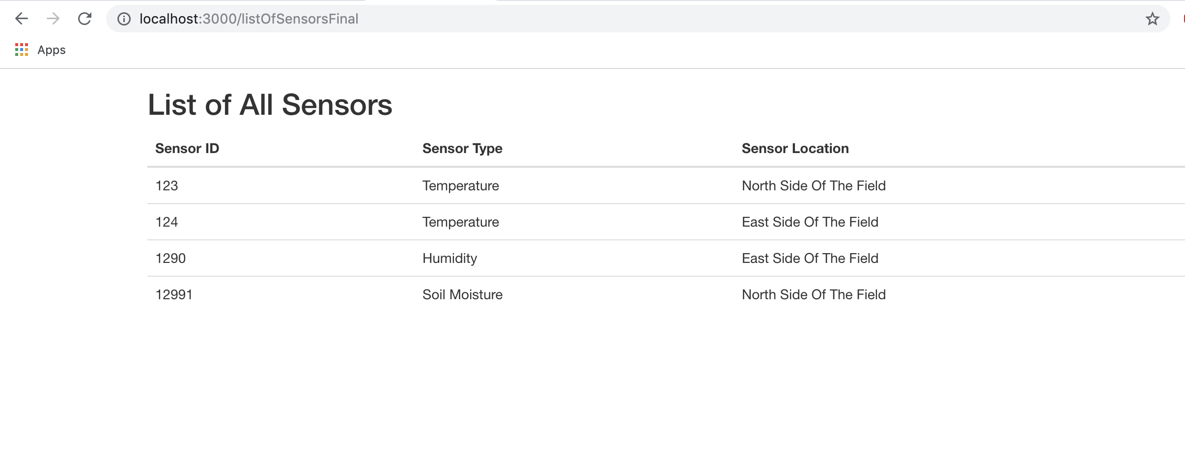
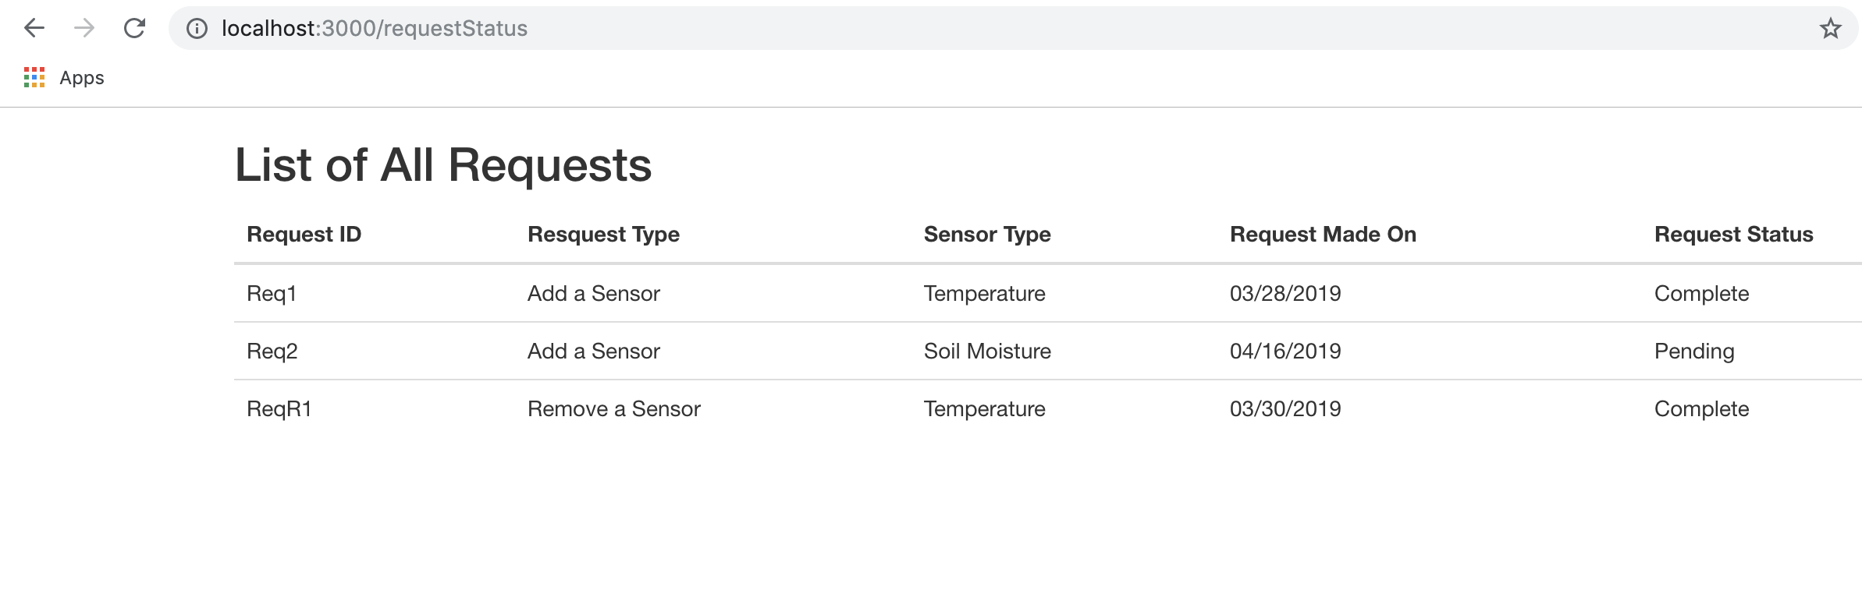
System Dashboard

Slide 39
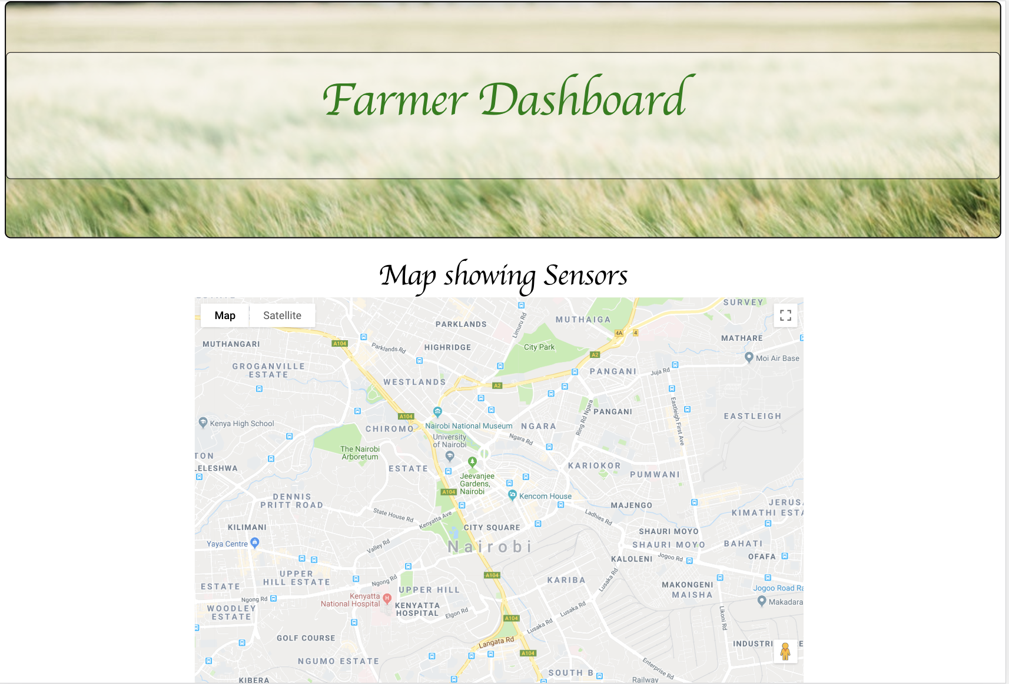
System Dashboard

Slide 40
Future Enhancement Plan
A more secure and protected data access
User Subscription and Billing
Technician account and permission management
Sensor data mining, processing and applied utilization using Machine Learning

Slide 41
THANK YOU

